Slide 1
Memory Leaks in High Level Programming Languages Part I
By Spencer Bartz

Slide 2

What is a memory leak?
A memory leak is a failure in a program to release discarded memory, causing impaired performance or a fatal error.
Memory leaks occur In OOP when an object is stored in memory but cannot be accessed by the running code. In Procedural languages which have system level memory allocation functions, reassigning pointer values, even character arrays, can cause the same problem by orphaning the memory block to which they originally pointed.
Allocating memory in a program typically occurs on a heap data structure and memory leaks can happen when that memory is occupied but no longer used. Some languages require explicit freeing up of memory, and others run a “garbage collector” as a background process that is supposed to clean up blocks of memory with no variables pointing to them.

Slide 3

Who cares? Won’t the OS or garbage collector just fix it for me?
Usually, but not always. In some cases the “garbage” cannot be collected because it is still allocated in a running process. There are many tools and techniques to track-down or prevent memory leaks, but the responsibility rests on the programmer so the buck stops with you!

Slide 4
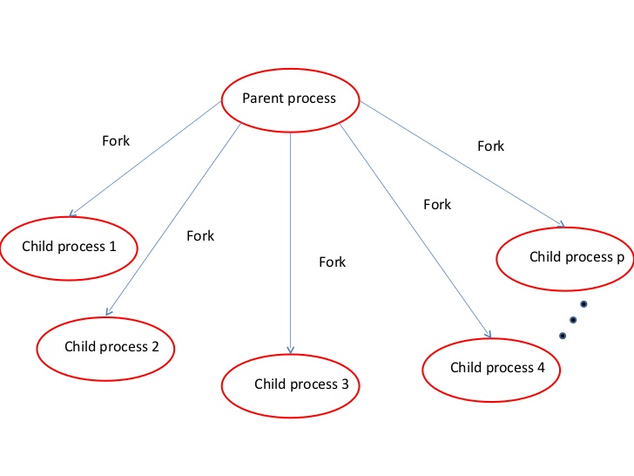
OK, but dude I have like 100 Petabytes of RAM. Who cares about one measly block?
In some cases, the amount of inaccessible memory grows over time.
Imagine a server to which many clients connect. The server (parent process) forks/spawns a “client handler” as a separate child process for each client connection. We end up with something like this:

Slide 5

How can the amount of leaked memory grow over time? It’s not like I’m feeding it miracle-grow...
Imagine the client handlers are actually web crawlers that store all their data in memory before writing to a file or database. Or worse yet, imagine the child processes spawn child processes of their own! (see Fig. 1 in next slide)
The crashed server cannot send a sigint or taskkill command to any of the child or grandchild processes. This situation would eventually render the machine unusable until it is restarted. If only the server is restarted, it won’t be aware of the children spawned by the previous run before the crash. This would contribute to the “down time” of an application in production.
This causes orphaned processes which are hard to track down.

Slide 6
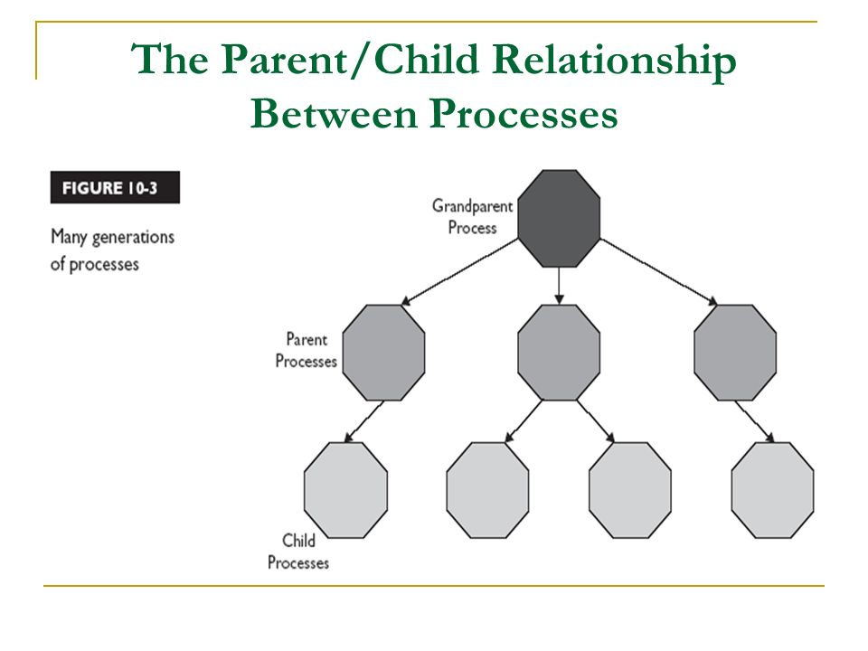
Fig. 1: Processes that fork other processes.

Slide 7

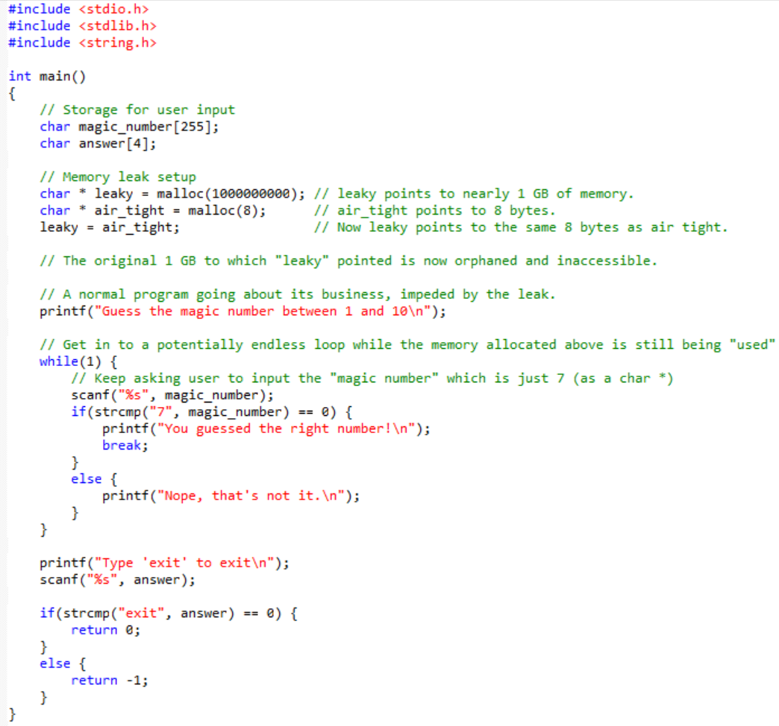
Let’s look at a concrete example:

Slide 8
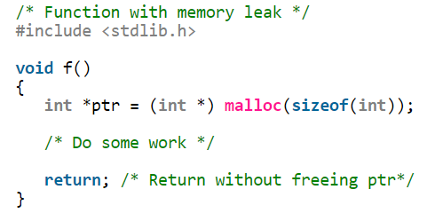
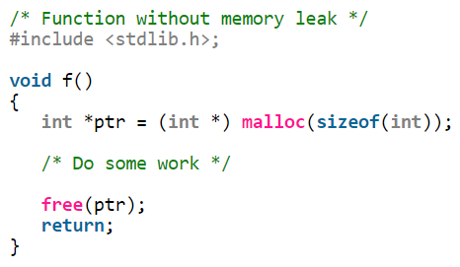
Scope: Allocated memory is not automatically freed up when its pointer goes out of scope.
Consider the following functions:
C has no garbage collector so even if ptr goes out of scope, the integer-sized block of memory allocated by malloc() is not freed up.
The function free() releases the allocated memory. It might help to think of malloc() and free() like begin end in Ruby or dare I say, Pascal!

Slide 9
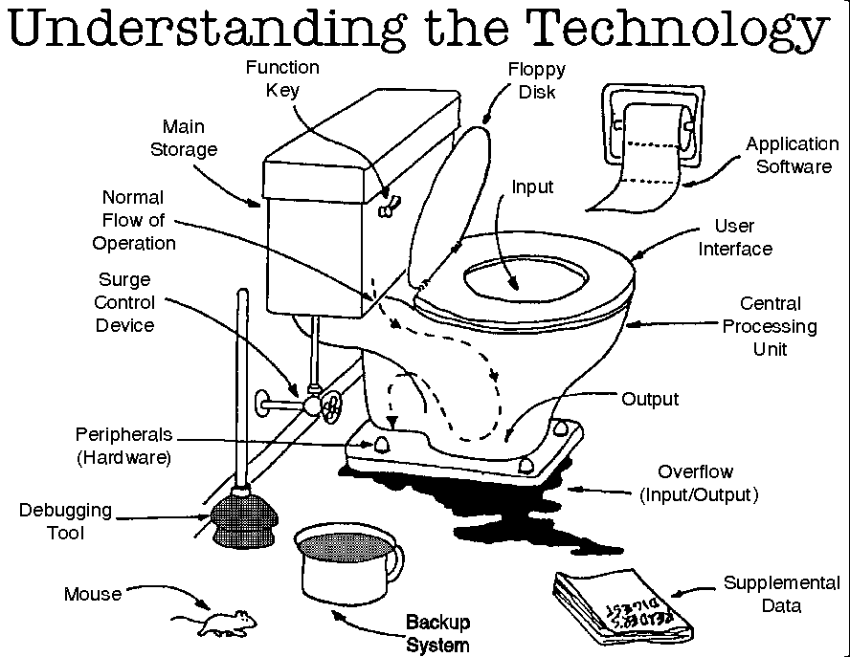
Next Time: Memory Leaks in type-safe languages and interpreted languages (e.g. Java and Python)

Slide 10
Reference Material:
http://www.geeksforgeeks.org/what-is-memory-leak-how-can-we-avoid/
https://plumbr.io/blog/memory-leaks/what-is-a-memory-leak
https://en.wikipedia.org/wiki/Memory_leak
http://practice.geeksforgeeks.org/problems/explain-memory-leak
https://www.ibm.com/developerworks/aix/library/au-toughgame/index.html
https://www.toptal.com/java/hunting-memory-leaks-in-java

